Slide 1
Advanced Control Design for Wind Turbines
Yuan Yuan
PhD candidate
University of Connecticut
August 9th, 2018
Corning Incorporated
Corning, NY, USA

Slide 2
Outline
PhD work
background & Control Method
Disturbance Observed Based control
Robust control
Model predictive control
Adaptive control
Work in Corning
Model predictive control in laminated glass
Concluding Remarks

Slide 3
Me
Current: Control scientist intern，Sullivan Park
PhD candaite:
Mechanical Engineering, University of Conneticut, Aug, 2013- December, 2018(expected)
Master degree: Eletrical Engineering (control theory and control engineering)
Northerwestern Polytechnical Unversity, China
Bachlor degree: Electrical Engineering (automation),
Northerwestern Polytechnical Unversity, China
Hobbies: Boating, and badminton.

Slide 4
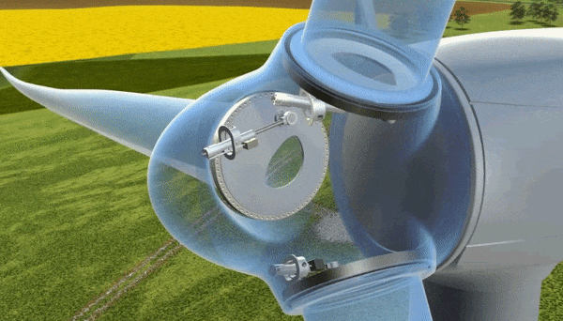
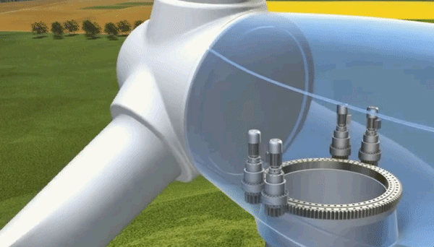
Background: Wind Turbine and Control
Wind Energy
Fastest growing renewable energy source in the world: The worldwide wind capacity reached over 400,000 MW by the end of 2015
Low cost & environmentally friendly
Pitch control animation
Wind turbine control loops
Generator torque control
Blade pitch control
Nacelle yaw control
Yaw control animation
Notes:
Collective individual

Slide 5
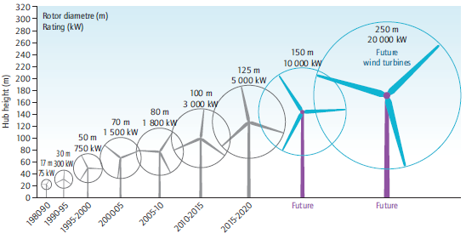


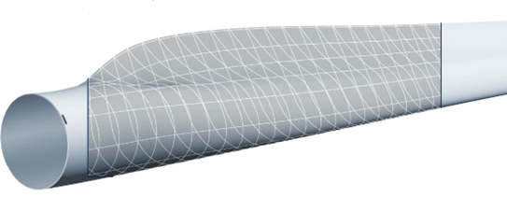
Challenges of Wind Turbines
Source: DOE
Goal: to reduce the cost of wind energy
Complex dynamics
Increased turbine size
Complex structures: airfoil-shaped blades
Uncertain environments
Time-varying wind speeds
Weather changes, icing, and assemblage error of turbine
Advanced controllers can help reduce maintenance cost and increase power capture

Slide 6
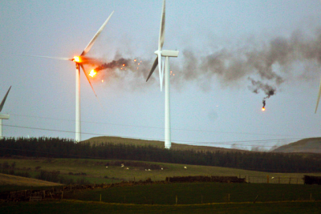
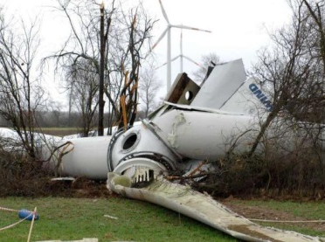
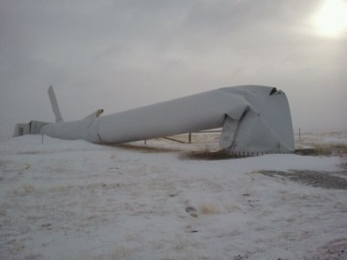

Research Objective
Different control goals
Speed control
Power control
Load reduction on components
Prolonged actuator life
Complex dynamics & uncertain environments
Conflicting objectives
Explore different control approach
6

Slide 7
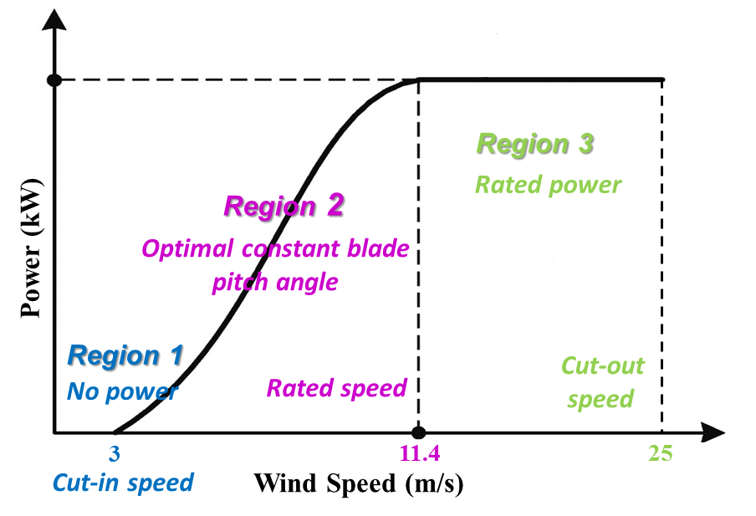
Operating Regions
Optimal balance between energy production performance and reliability of components
Region 3: pitch control
Maintain the rated generator speed
Mitigate structural loads
Control laws
Disturbance observer based control
Robust control
Model predictive control
Adaptive control
Region 2: torque control^{[1]}
Maximum power
[1] Jonkman et al., National Renewable Energy Laboratory Technical Report, 2009.

Slide 8
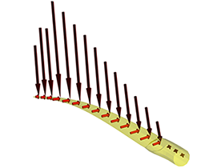
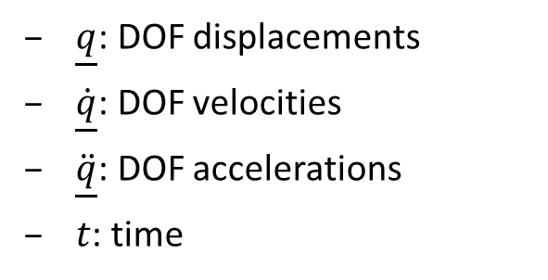
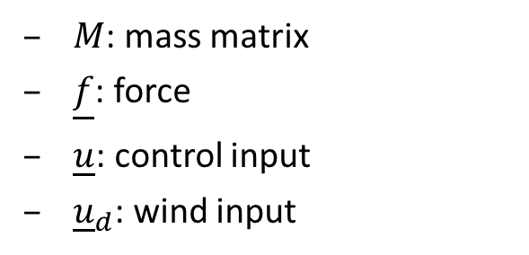
Dynamic modeling
AeroDyn
An aero-elastic simulation code (by NREL) to predict the aerodynamics
Input: steady or turbulent wind file
Output: force and moment on the turbine components
Nonlinear aero-elastic equations of motion of wind turbine system
$M$: mass matrix
$\underline{f}$: force
$\underline{u}$: control input
${\underline{u}}_{d}$: wind input
$\underline{q}$: DOF displacements
$\underline{\dot{q}}$: DOF velocities
$\ddot{\underline{q}}$: DOF accelerations
$t$: time

Slide 9
Model Linearization
FAST (Fatigue, Aerodynamics, Structures, Turbulence)
FAST code (by NREL) used for simulating the coupled dynamic responses of wind turbines
State space representation
Numerically linearize the equation by perturbing (∆) each variable about their respective operating points (op):
linearization

Slide 10
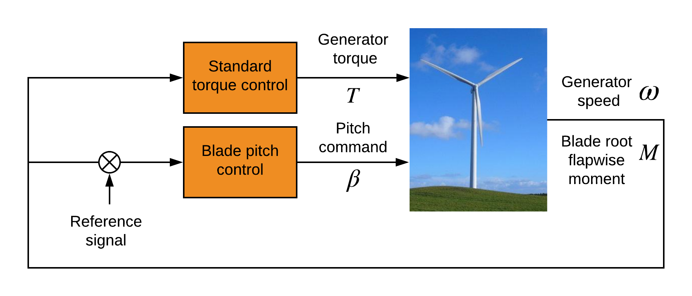
Control Architecture
Torque control: Standard torque control
Pitch control: Model predictive control
Yaw control: Not involved

Slide 11
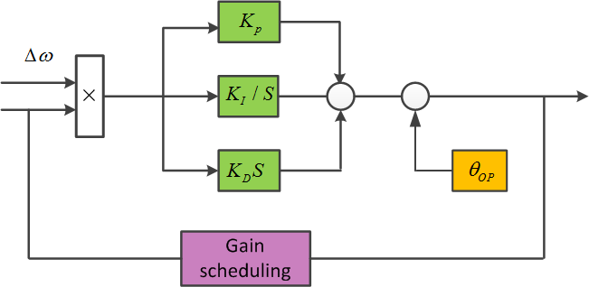
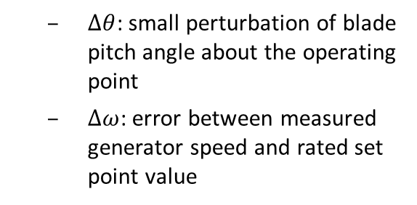
Baseline Pitch Control
Baseline Gain Scheduling Proportional Integral Derivative pitch controller ^{[1]}
$∆θ$: small perturbation of blade pitch angle about the operating point
$∆ω$: error between measured generator speed and rated set point value
Gain scheduling factor to accommodate time-varying operating wind condition
$θ_{k}$: blade pitch angle at which the pitch sensitivity is doubled from its value at the rated operating point.
Gain scheduling: $K_{p }{,K}_{I}$, $K_{D}$ are changed
[1] Jonkman et al., National Renewable Energy Laboratory Technical Report, 2009.
.

Slide 12
Outline
Background
Research Objective
Disturbance observer based control
Concluding Remarks
Future Tasks
Notes:
This is an outline of my presentation, first, background

Slide 13



Disturbance Observer Based Control
Disturbance observer based control
High precision motion control
Micronano manufacturing
Advantage: great disturbance rejection performance
Promising to make improvements in wind turbine control area
Objective: speed and power control, load mitigation at some components
How is this control strategy tailored for complex wind turbine dynamics
Notes:
The utre 1……is DOB…this another good way to address speed and power control for the wind turbine..
It is actually the latest progress in high precision motion control. So far, it has been applied successfully to micronano manufacturing. But……It is highly promising to make fundamental improvement in the turbine blade control
Actualy Our preliminary result shows DOB is capable of regulating speed and power. Which is the first sucefful example of using DOB controller of wind turbine.
Let us see…
Height:10nm width 100nm
Next we will explain why this DOB controller can help

Slide 14
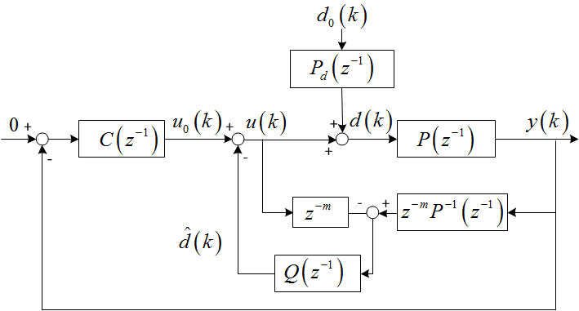
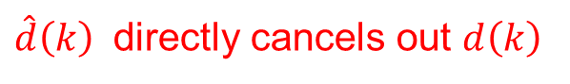
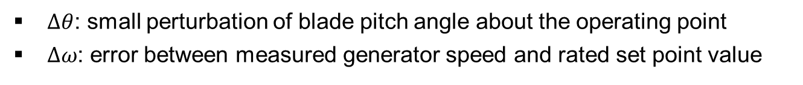
Disturbance Observer Based Controller
$d_{0}\left(k\right)$:
wind disturbance
$P_{d}\left(z^{−1}\right)$:
disturbance model
$P\left(z^{−1}\right)$:
plant model
$P^{−1}\left(z^{−1}\right)$:
model inversion
$Q\left(z^{−1}\right)$:
filter
$C\left(z^{−1}\right)$:
PID controller
Why this controller?
Gain-scheduling PID: perfect gain correction is not strictly guaranteed
Augmented controller: inner-loop can further reject low frequency disturbance based on the disturbance suppression of the outer-loop.
den
num
$\hat{d}\left(k\right)$ directly cancels out $d\left(k\right)$
0
filter Q
Notes:
Here we quickly go through the essential details
It is an inverse-based disturbance cancelation scheme. We want to use d hat to directly cancel out d
The inner loop is the disturbance observer structure, the outter loop is the gain-scheduled PID controller. Both of them will contribute to disturbance rejection.
The P inverse should be stable
The fundamental idea is to make the differnec eto be 0
Through the equations, we can derive filter Q
For any signal d0 it will satisfy this eq. where Bd is numerator of z transofrm of d0. Ad is the corsponding den.

Slide 15
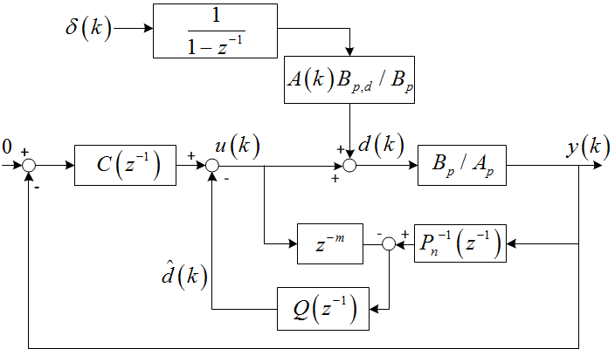
Disturbance Observer based controller
Persistent wind disturbance input:
unknown amplitude, known waveform
step disturbance
Wind disturbance: Variance between nominal wind speed and the operating wind speed
Disturbance rejection is achieved if
Notes:
We assume in this reseach, dot
Take z transform of step. And from the loop shaping of previuos control sheckem,
So under the step disturbance, we can derive the expression of d
The FIR filter K is added to ensure the causality of Q
We also introduce an extra item in the denominator, where the design of belta is used to tune the local loop shaping. based on the damped pole –zero pair pinciple.
The effect of the choice of belta will be explained in details later.
When there is no belta, the shape of Q is certain ,we can not tune it. Belta can change the shape of Q, then we can tune it. Look at the figure.

Slide 16
5-DOF Linearized Model (Preliminary Result)
5 DOF: Generator DOF, drivetrain torsional flexiblity DOF, and first flapwise blade mode DOF (three blades)
Further analysis is needed to deal with the nonlinearities
Notes:
To obtain the preliminary result of the DOB controller, we first apply the controller into the 5-DOF linearized model
These are the
The result seems to be promising, so how is it with the nonlinear plant

Slide 17
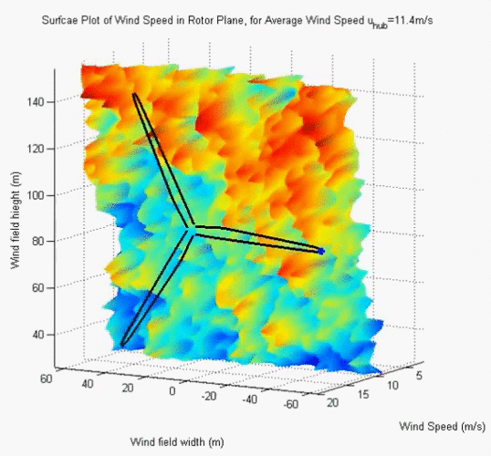
Case Study: Nonlinear plant
Case study:
Test wind turbine
NREL offshore 5-MW baseline
wind turbine
Degree of freedom (DOF)
16 DOFs*
Turbulent wind field
Simulation time
Run time: 0 to 600 s
Integration step size: 0.0125 s
Blade pitch limit and pitch rate limit ^{[1]}
Minimum/maximum blade pitch: 0 degree / 90 degree
Maximum absolute blade pitch rate: 8 degree/s
[1] Jonkman et al., 2009, National Renewable Energy Laboratory, Golden, CO.
*First flapwise blade mode (3 blades), second flapwise blade mode (3 blades), first edgewise blade mode (3 blades), drivetrain rotational-flexibility, generator, yaw, first fore-aft tower bending-mode, second fore-aft tower bending-mode, first side-to-side tower bending-mode, second side-to-side tower bending-mode.

Slide 18
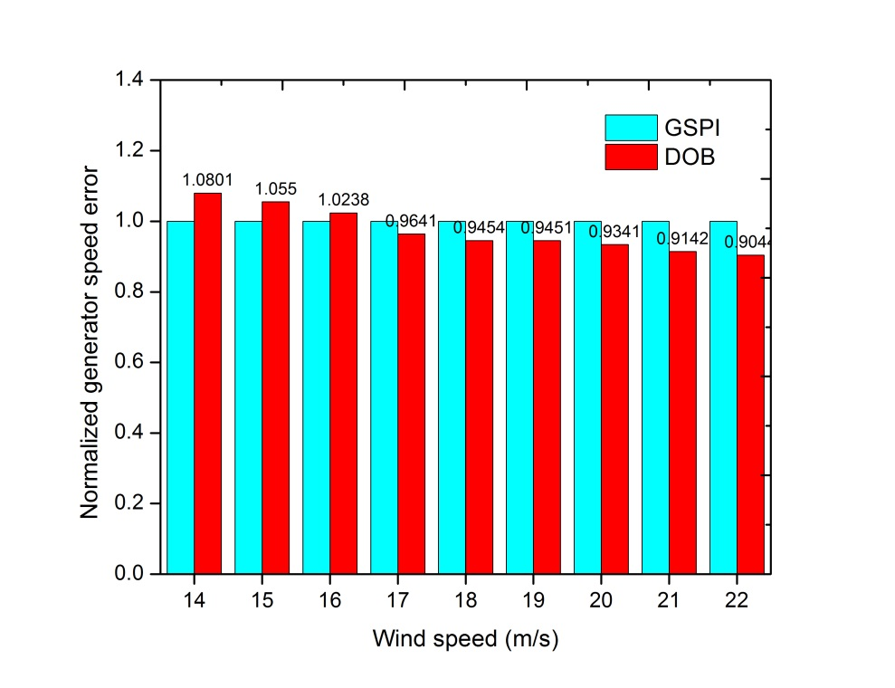
Performance comparison
Results:
3.59% - 9.56% decrease in 6 wind fields
2.38% - 8.01% increase in 3 wind fields
Limited performance due to trade-off with respect to the stability issue
Notes:
This slide shows the results based on the selected Q filter
The first figure is wind speed
The second figure is the …response under 18
We can see
To test robustness of the DOB controller, we applied it to wide wind speed region from 14 to 22.
We can find there is …..
So what more we can do?

Slide 19

Trade-off in selection of Q filter
Trade-off between disturbance rejection region and disturbance amplification region:
Disturbance amplification:
Instability of the nonlinear plant (model mismatch exists)^{[5]}
Sensitivity function:
under different
[5] Doyle et al., Feedback Control Theory, 1990.
Notes:
Here we will talk about how to make a trade off in selection of Q filter. Specifically it is the trade-off between ……
In practice, when DOB controller is applied to nonlinear controller, the disturbance amplification at high freuqencies will lead to the insatiability of …..
Actually the value of belta is related to sensitivity function. This equation in the red box is an indicator of sensitivity function. We check the fre response of it under differernt belta.
From the figure we can see the samller belta will lead to wider disturbance rejection region, but at the same time the larger disturbance amplification. Which will influence the stability of system.
Finally we choose belta =.997.

Slide 20
Add-on compensator
Faster roll-off at high frequencies
Low pass filter
Q filter (DOB)
Q* filter (DOB*)
Smaller disturbance amplification at certain high frequencies in Q*
Better disturbance rejection in low freq.
Sensitivity function
Notes:
Next we will introduce how to improve the tracking perfromance. We propose to use an add-on compes

Slide 21
Performance comparison
FFT

Slide 22
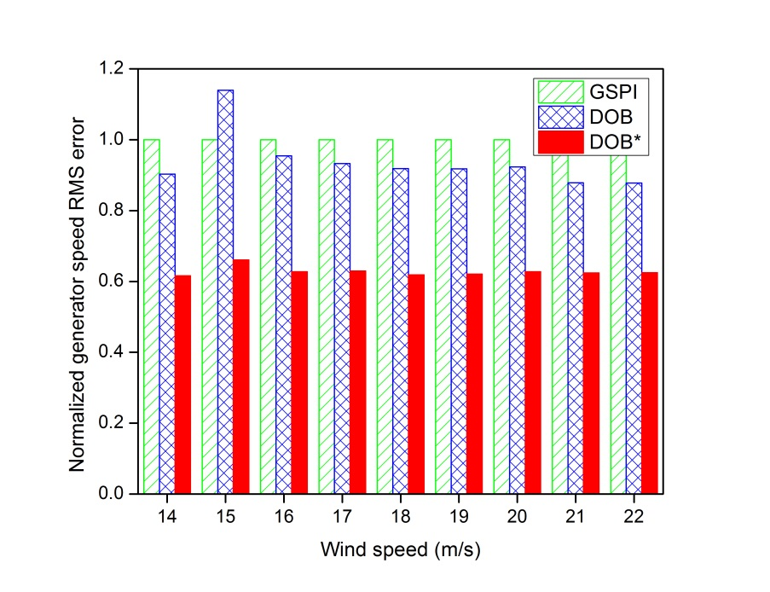
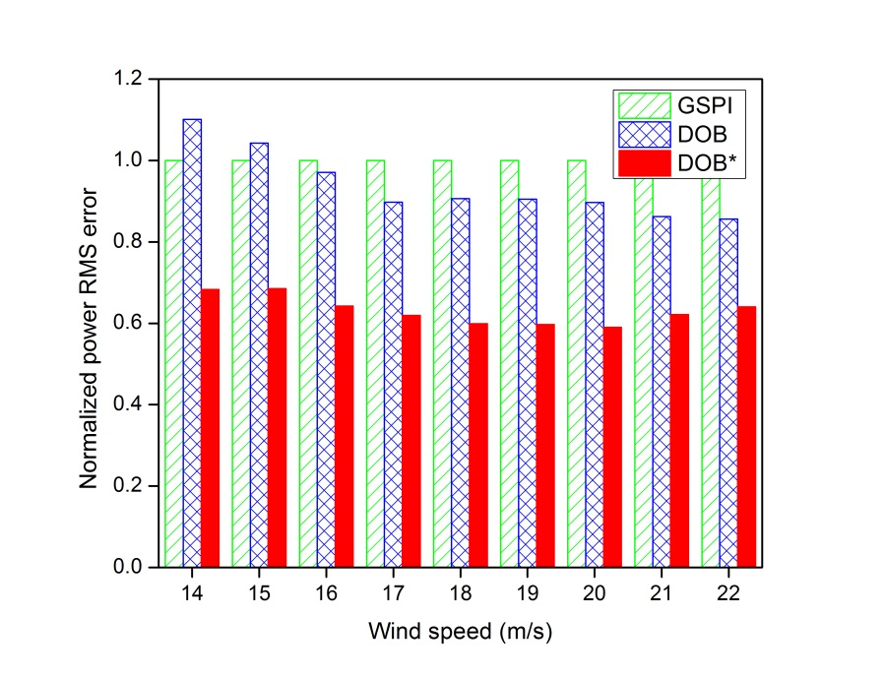
Performance comparison
Normalized generator speed RMS error: -28.13% to -39.14%
Normalized power RMS error: -31.43% to -40.93%
Conclusion:
Enhanced generator speed and power regulation with DOB* in Region 3

Slide 23
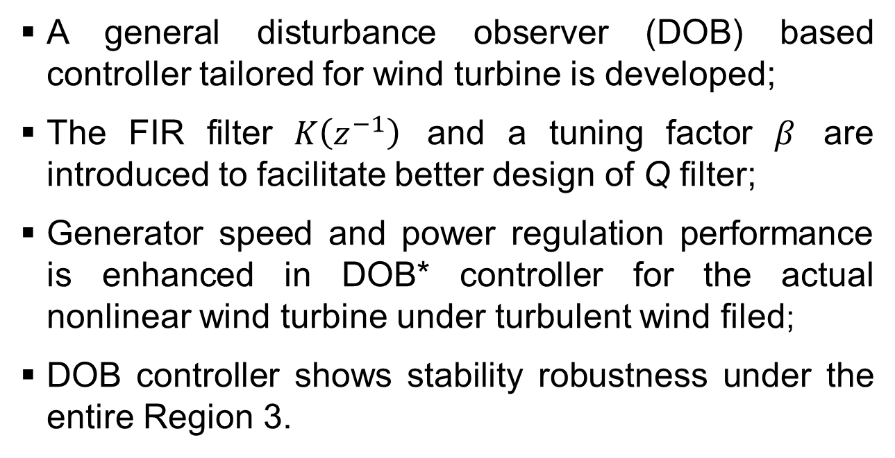
Concluding Remarks
A general disturbance observer (DOB) based controller tailored for wind turbine is developed;
The FIR filter $K\left(z^{−1}\right)$ and a tuning factor $β$ are introduced to facilitate better design of Q filter;
Generator speed and power regulation performance is enhanced in DOB* controller for the actual nonlinear wind turbine under turbulent wind filed;
DOB controller shows stability robustness under the entire Region 3.
This research is supported by NSF under grant CMMI – 1300236
Notes:
simulation software

Slide 24



Periodic Wind Disturbance Rejection using Robust Individual Control Strategy
Yuan Yuan, X. Chen, J. Tang
Mar 5, 2018
Department of Mechanical Engineering
University of Connecticut
Storrs, CT, USA
Photo by NREL

Slide 25
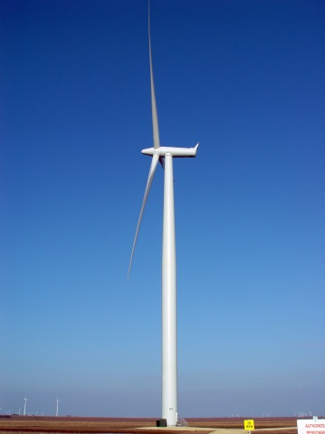
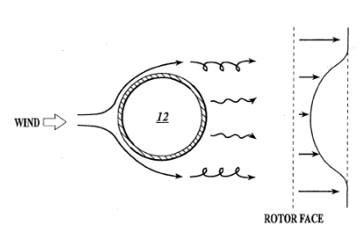
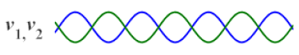
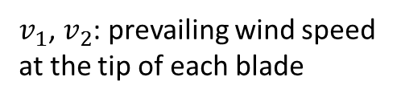
Motivation₁
Individual pitch control to mitigate periodic loads
Enabled by recent hardware advancements
Tower shadow and wind shear effects
Periodic loads
Tower shadow
Wind shear
different wind speed at different height
wind
wind
upwind turbine
downwind turbine
$v_{1}$, $v_{2}$: prevailing wind speed at the tip of each blade
Tower top

Slide 26

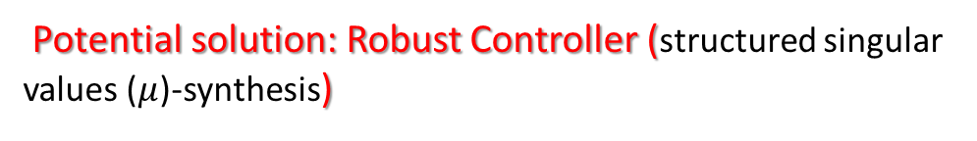
Motivation₂
Challenges for wind turbine control:
Model uncertainties
Periodic loads on blades
Coupling dynamics of 3-bladed pitch system
Objective:
Speed and power regulation in high wind speeds
Mitigate periodic loads
Robust stability and robust performance
Source: Liebherr
Difficulties in designing controller:
Operating point varies constantly – actual dynamics is different from nominal model
Potential solution: Robust Controller (structured singular values ($μ$)-synthesis)
Notes:
One potential solution is

Slide 27
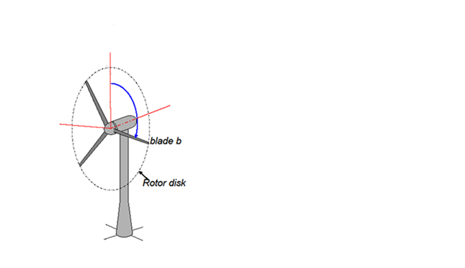
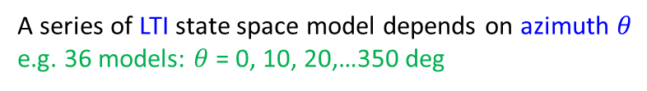
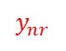
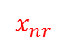
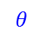
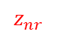
Dynamics and modeling
Modeling including periodic dynamics
$$z_{nr}$$
Steady state: blade motion is a Fourier series equation
$$θ$$
$$x_{nr}$$
linearization
Periodic LTV state space model
$$y_{nr}$$
A series of LTI state space model depends on azimuth $θ$
e.g. 36 models: $θ$ = 0, 10, 20,…350 deg
MBC transformation
transform from rotating coordinates to nonrotating coordinates
Bir, G.S., 2010. User's guide to MBC3: Multi-blade coordinate transformation code for 3-bladed wind turbine.
An average state-space system is obtained from the complete set of linearizations at N azimuth angles by computing
Notes:
The dynamics of wind turbine rotor blades are generally expressed in rotating frames attached to the
individual blades. The tower-nacelle subsystem sees the combined effect of all rotor blades, not the
individual blades. This is because the rotor responds as a whole to excitations such as aerodynamic gusts,
control inputs, and tower-nacelle motion—all of which occur in a nonrotating frame. Multi-blade
coordinate transformation (MBC) helps integrate the dynamics of individual blades and express them in a
fixed (nonrotating) frame. MBC involves two steps: transformation of the rotating degrees of freedom,
and transformation of the equations of motion.
MBC transformation can reduce the variations between linearizations obtained at different azimuths, and therefore yields a better representation of the turbine dynamics

Slide 28
Uncertain model structures
Uncertain model structure formulation
LTI state space model
Pick nominal model: 18 m/s
Challenge: wind speed changes so actual dynamics changes
Fit an uncertain model structure to an array of LTI responses :
14 m/s, 16 m/s, 20 m/s, and 22 m/s
Frequency responses comparison
Model mismatch in high frequency regions
Uncertain model structures

Slide 29
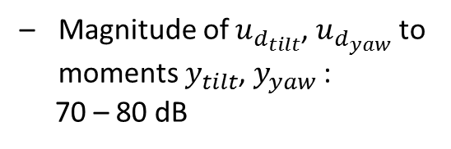
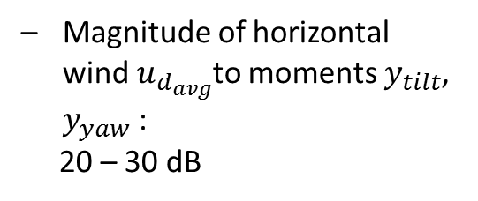
Shear components
Horizontal and vertical wind shear effects to dynamic modeling
Magnitude of $u_{d_{tilt}}$, $u_{d_{yaw}}$ to moments $y_{tilt}$, $y_{yaw}$ :
70 – 80 dB
Magnitude of horizontal wind $u_{d_{avg}}$to moments $y_{tilt}$, $y_{yaw}$ :
20 – 30 dB
Bode Diagram has large magnitude
Include wind shear components in the model

Slide 30
Control architecture formulation
Control architecture formulation
Collective loop:
Speed and power regulation
GSPI/DOB ^{[1]}
Individual loop:
Periodic load mitigation and modeling uncertainties
Robust control with weighting function selection
[1] Yuan, Y., Chen, X., and Tang, J., 2017, "Disturbance Observer-Based Pitch Control of Wind Turbines for Enhanced Speed Regulation," Journal of Dynamic Systems, Measurement, and Control, V139(7), pp. 071006.

Slide 31
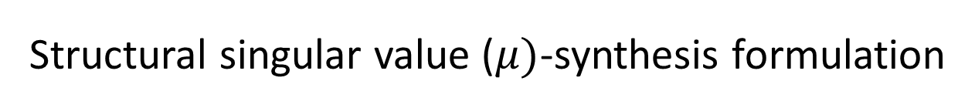

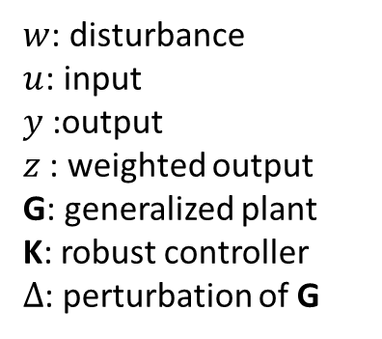
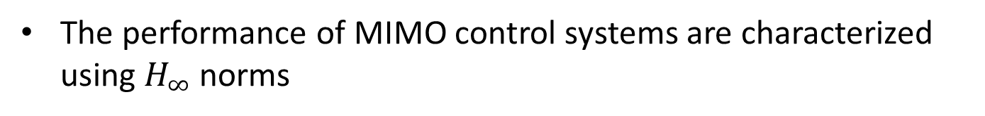
Structural singular value ($μ)$-synthesis formulation
Advantages using structural singular value-synthesis
RSRP (robust stability and robust performance) guarantee under model uncertainties due to operating point variation
Disturbance rejection via weighting function selection
M-$∆$ structure
$w$: disturbance
$u$: input
$y$:output
$z$: weighted output
G: generalized plant
K: robust controller
$∆$: perturbation of G
The performance of MIMO control systems are characterized using $H_{∞}$ norms

Slide 32
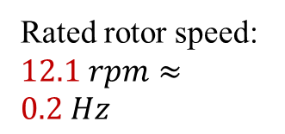
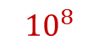
Power spectral density
Power spectral density (PSD) of blade 1 root flapwise moment with only collective loop
$${10}^{8}$$
1P
Rated rotor speed: $12.1 rpm≈0.2 Hz$
2P
3P
4P
Severe limits:
Multiple peaks at 1P (per revolution), 2P, 3P, … frequencies due to periodic loads on
Component failure

Slide 33
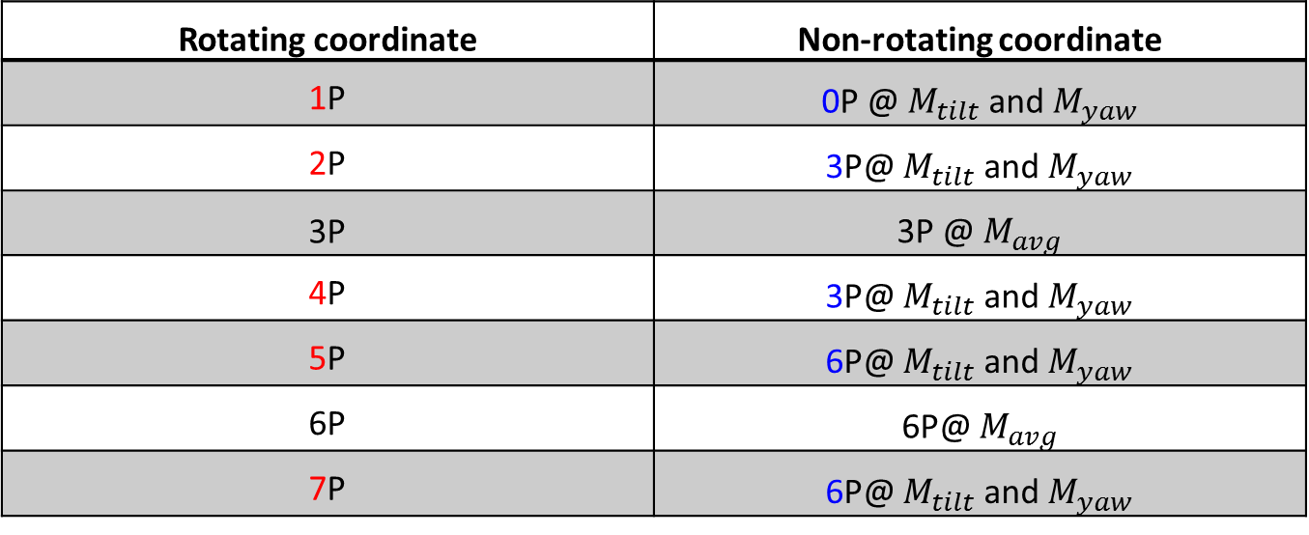
Weighting functions
Frequency effects change due to coordinates change
Rotating coordinate | Non-rotating coordinate
1P | 0P @ $M_{tilt}$ and $M_{yaw}$
2P | 3P@ $M_{tilt}$ and $M_{yaw}$
3P | 3P @ $M_{avg}$
4P | 3P@ $M_{tilt}$ and $M_{yaw}$
5P | 6P@ $M_{tilt}$ and $M_{yaw}$
6P | 6P@ $M_{avg}$
7P | 6P@ $M_{tilt}$ and $M_{yaw}$
Sensitivity function
Minimize the norm
Further penalize the control input and output performance

Slide 34
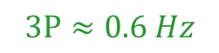
Weighting functions
Select weighting functions
low pass filter
$$3P≈0.6 Hz$$
low frequency

Slide 35
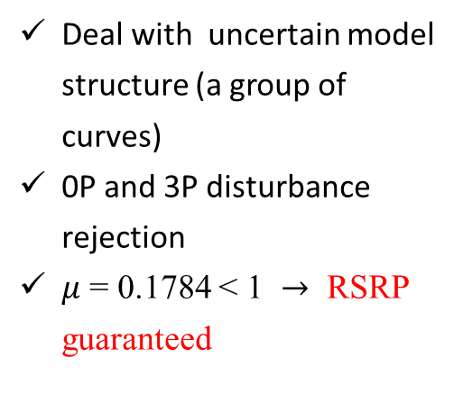
Singular values
Multivariate transfer functions: singular values of transfer function
Open-loop and closed-loop responses of the nonlinear wind turbine under turbulent wind excitations
Deal with uncertain model structure (a group of curves)
0P and 3P disturbance rejection
$μ$ = 0.1784 < 1 $→$ RSRP guaranteed
Notes:
The shaping of multivariate transfer functions is based on the idea that a satisfactory definition of gain for a matrix transfer function is given by the singular values of the transfer function

Slide 36
PSD results
PSD result analysis at multiple frequencies
18 m/s turbulent wind field excitation
Significant 1P, 2P, and 4P peak reduction

Slide 37
Load analysis
Blade and tower fatigue damage equivalent load (DEL) comparison
(DEL: industrial standard)
Collective control
PID individual control
Robust individual control
Blade flapwise: Robust: -20% of PID
Blade edgewise: same level
Tower base fore-aft: 3%-10% decrease
Tower base side-side: same level

Slide 38
Concluding remarks
A robust controller with mu synthesis for wind turbine is developed;
Individual pitch control is utilized to reject periodic loads;
Robust control strategy is formulated to tackle with modeling uncertainties;
Periodic loads on blades are significantly reduced.

Slide 39
Multiple Objectives in Wind Turbines
Different control goals
Speed control
Power control
Load reduction on blades, tower and drive-train
Prolong actuator life
Challenges of multiple objectives
Designing individual controllers for each objective is getting more and more complex
Conflicting with each other
We need one controller that can balance all the objectives together
Model predictive control:
Online optimization of multiple control objectives
Notes:
To reduce the overall cost, we have several…first we need the speed control to keep the rotor at the rated value when wind speed is very high. If the rotor is over-speed, it will cause the over-heat of the generator and make the turbine on fire as shown in the first figure.
Also we want the power control, to make sure we capture the maximum power from wind when wind speed is not that high.
In addition, we can see there are a lot of components failure, the tower may fall and blade may crack. We need to reduce the loads.
Also, the life of actuators has its limit, changing them too often will increase more costs. So that we need to prolong the actuator life.
However,…..it is quite challenging when we realize multiple objectives
In this research, we choose MPC to achieve the optimization….

Slide 40
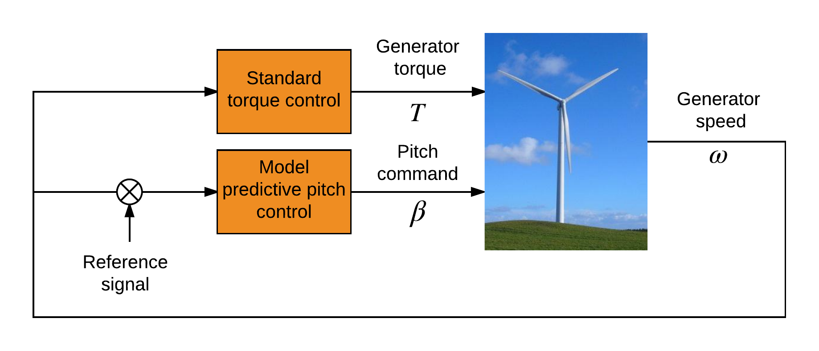
Control Architecture
-
Torque control: Standard torque control
Pitch control: Model predictive control
Yaw control: Not involved
Notes:
The yaw control is not involved, similar to other studies.

Slide 41
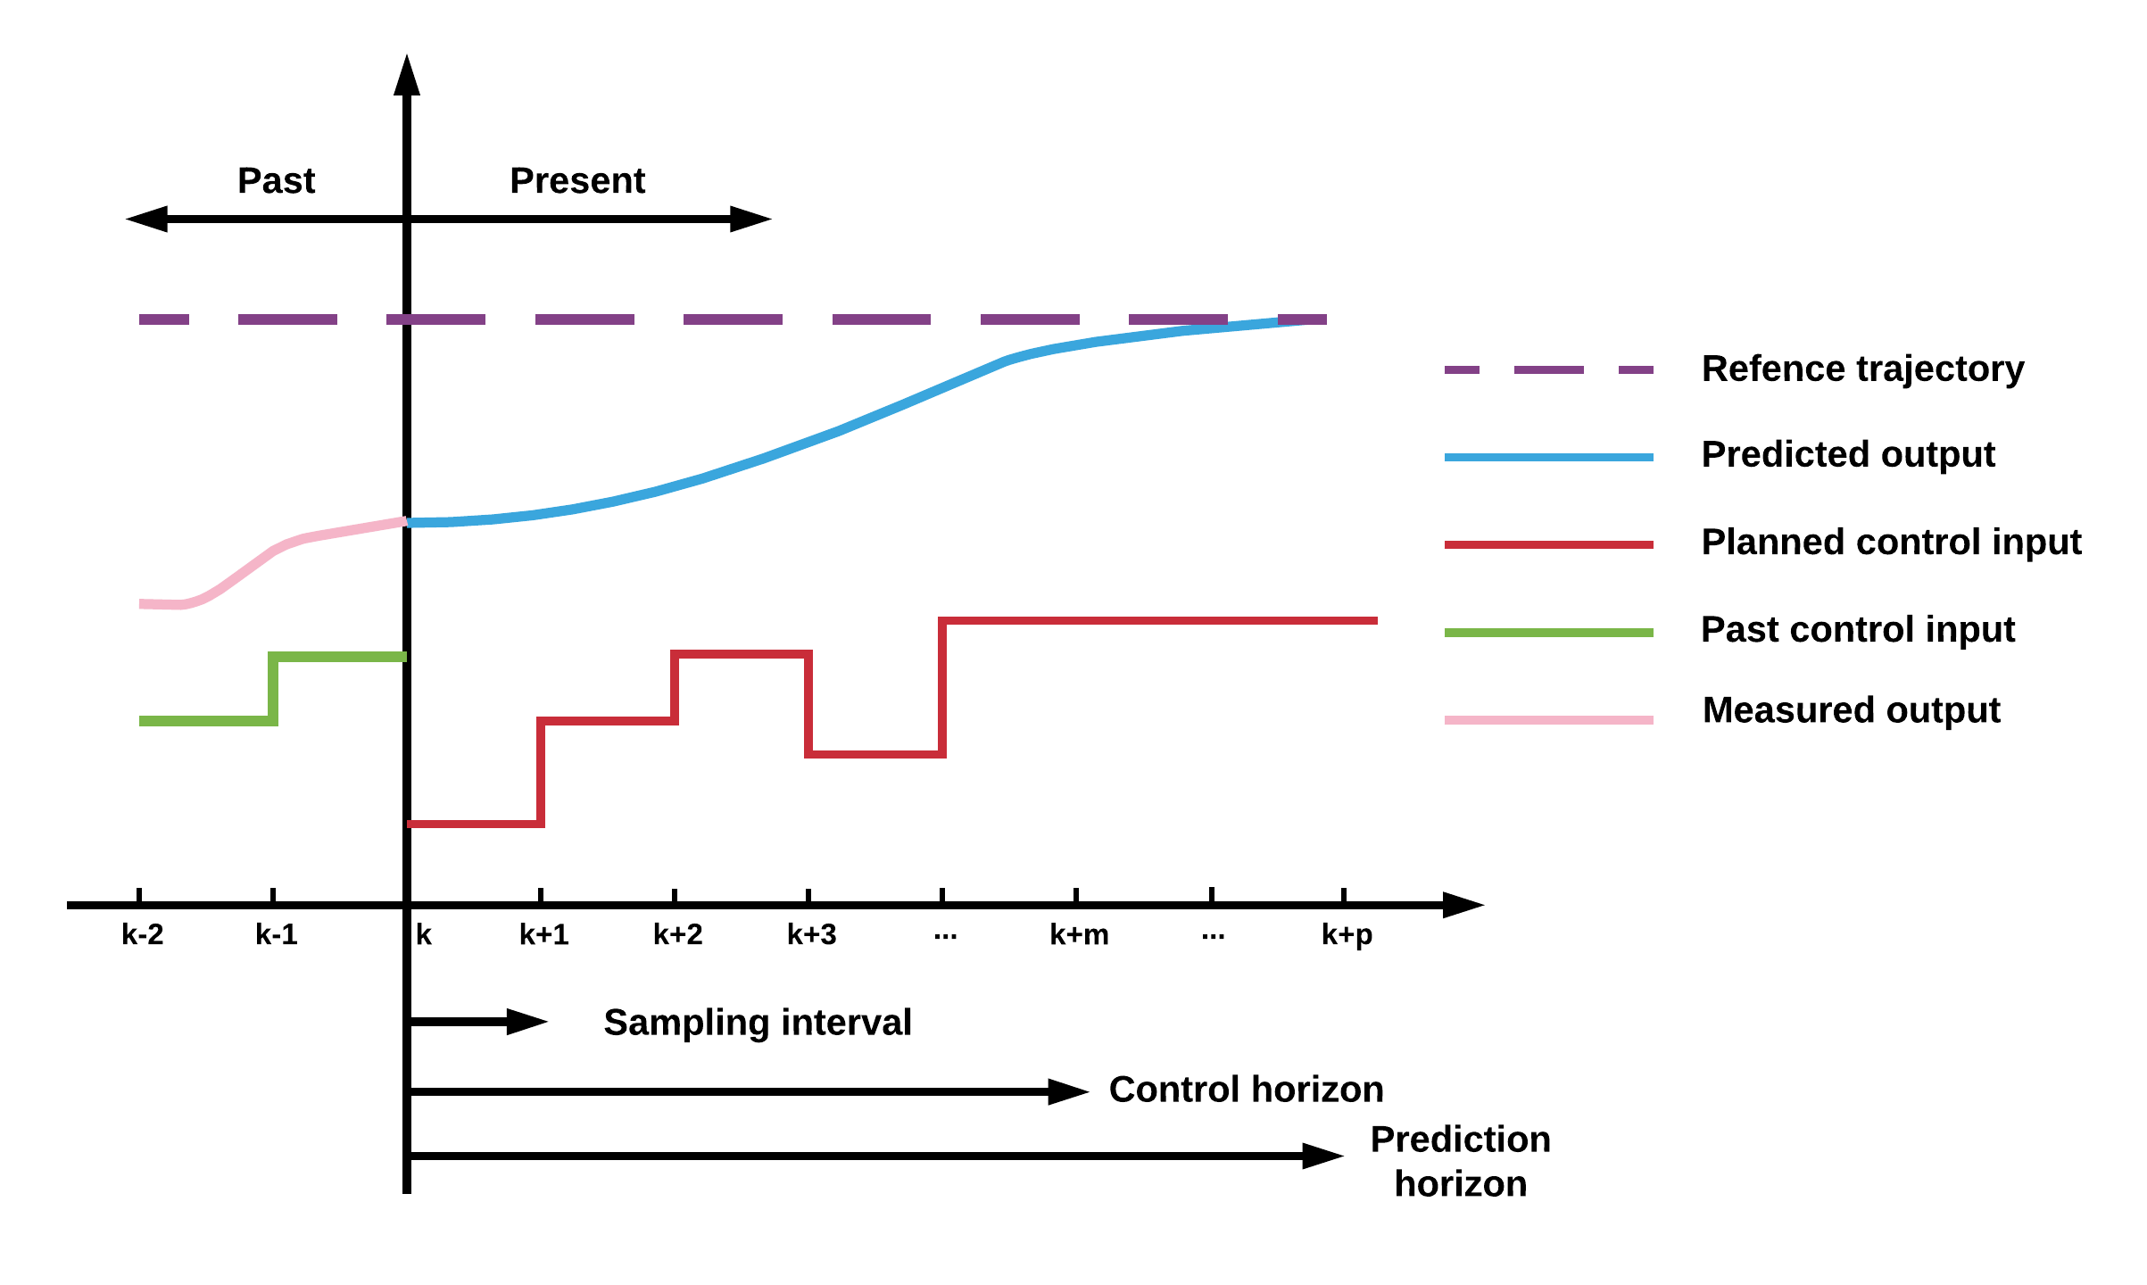

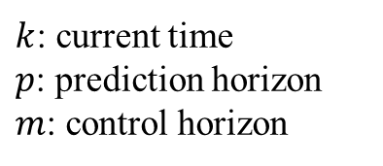
Model Predictive Controller (MPC)
$k$: current time
$p$: prediction horizon
$m$: control horizon
Model predictive control (MPC): regulatory controls that use an explicit dynamic model of the response of process variables to changes in manipulated variables to calculate control “moves”
Control moves are intended to force the process variables to follow a pre-specified trajectory
Notes:
This is an overview of model predictive controller, when we talk about MPC ,we are talking about using..
We have our manipulated variables , the planned control input
and we also have our process, the measured output and the past control input. We want to drive the predicted output close to the reference trajectory
What we are going to do is based on the information at time k to calculate the control input in the next step

Slide 42
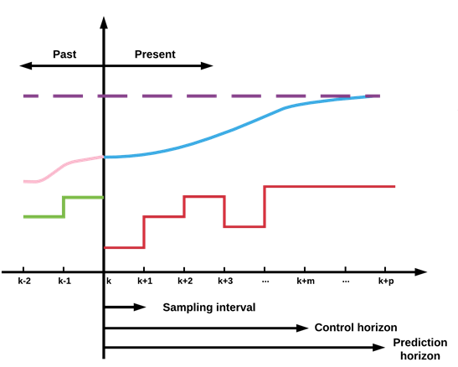
Model Predictive Controller (MPC)
Predicted outputs
Cost function
Notes:
In order to predict the outputs, we need a prediction model. The model can be linear , nonlinear.. First principle model and hybrid models.. Here we use linear model from FAST.
The predicted outputs are a function of current state, past control input, future control input and unmeaured disturbances. The disturbance can be estimated by the Kalman filter.
What are we going to do next is using a cost function which can penalize the tracking error and control effort.

Slide 43
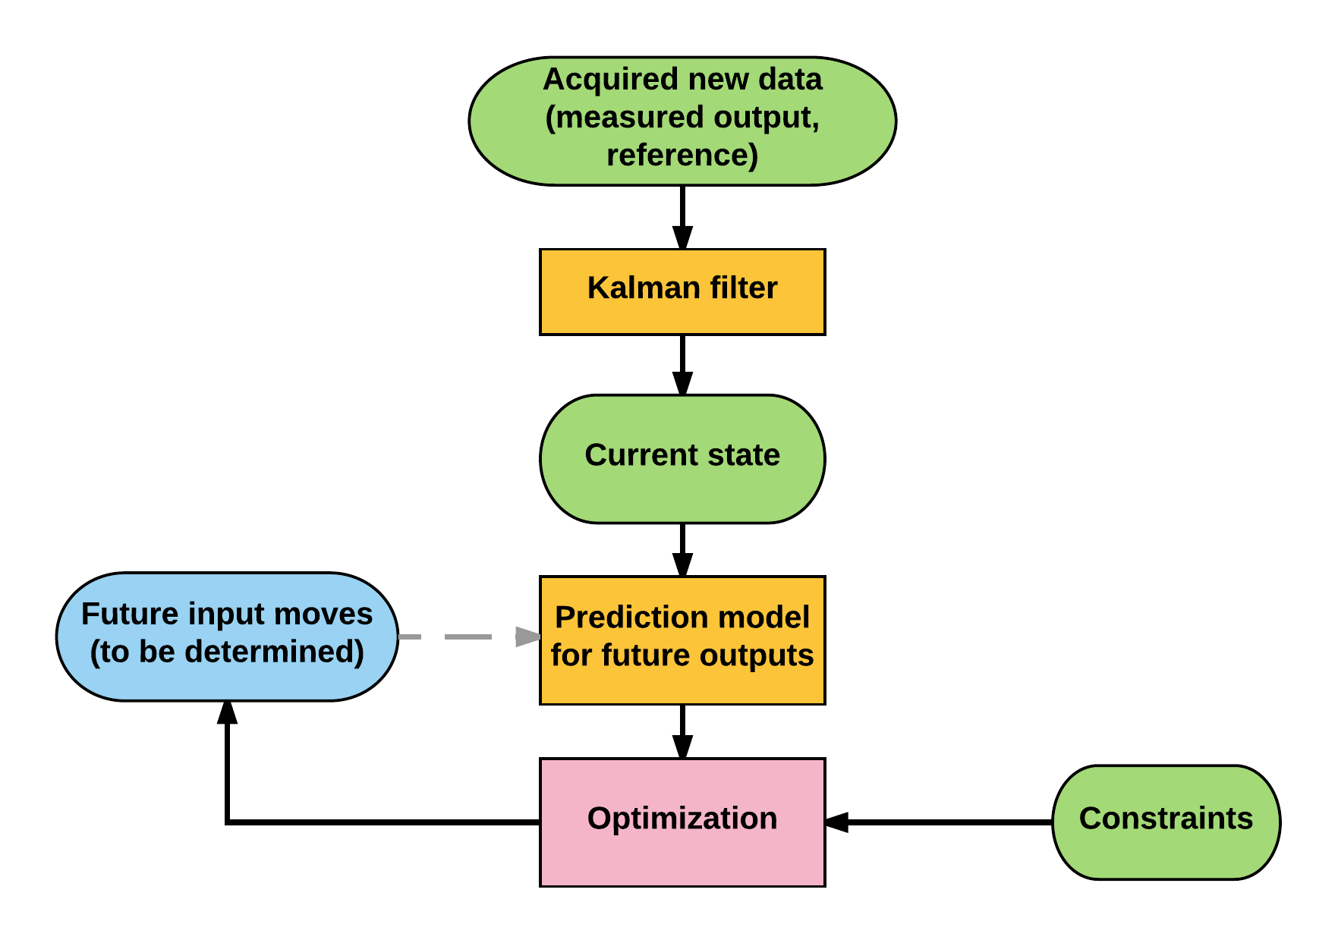
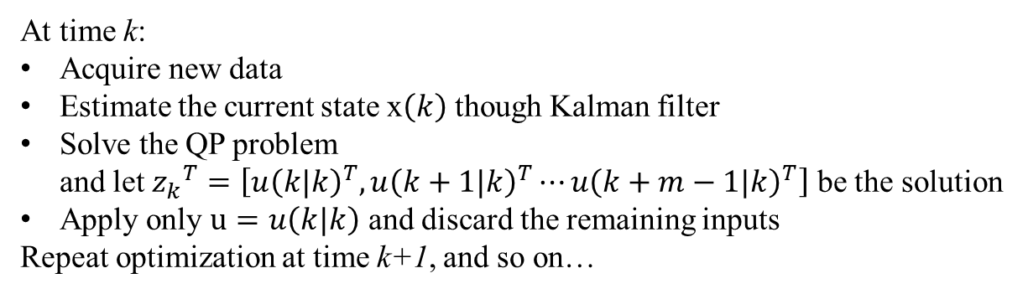
Model Predictive Controller (MPC)
Optimal solution
Find
to minimize
subject to
Optimization steps:
At time k:
Acquire new data
Estimate the current state x$\left(k\right)$ though Kalman filter
Solve the QP problem
and let ${z_{k}}^{T}=\left[{u\left(k|k\right)}^{T},{u\left(k+1|k\right)}^{T}⋯{u\left(k+m−1|k\right)}^{T}\right]$ be the solution
Apply only $u=u\left(k|k\right)$ and discard the remaining inputs
Repeat optimization at time k+1, and so on…
Notes:
So the problem is to find an …..that is the control sequences of next m steps based on the information at time k
Upper and lower limits
Take the first move out of calculated control sequences to implemete. At next time step, everything shifts over by one, and recalculate moves based on the measurements at th samp
Since it is on-line optimization, the controller can reject the Unmeasured disturbances , and the influence the process model errors can be taken care of

Slide 44
Switching Region Performance
Wind fields:
11 m/s, 12 m/s, 13 m/s
Results:
Power: Nearly same
Speed : better
Tower fore-aft loads: reduced
Tower side-side loads: mixed
Blade edgewise loads: nearly same
Blade flapwise loads: reduced
Pitch actuator: reduced

Slide 45
Adaptive Controller
Challenges for wind turbine systems:
Complex dynamics
Uncertain environments
Objective:
Generator speed at rated value and reduce oscillation
Mitigate loads
Near-term performance(constant speed)
Long-term reliability (less failure)
Source: Liebherr
Difficulties in designing controller:
System parameters not completely known
inherent model nonlinearities
unmodeled modes
manufacturing and assemblage tolerances
external operating uncertainties
Adaptive Controller
Notes:
Here comes our proposed adaptive controller, challenges…. Complx…and uncertain….
The large flexible structure operate in uncertain enviroments may have a lot unexpected failure
So the objective….
But there are diffculties to design such a contro….
We can not com….know sytem…due to..

Slide 46
Adaptive Controller
Method:
Model reference adaptive control (MRAC) with a disturbance accommodation controller (DAC): Two-layer structure
Control layer 1: DAC layer (closed-loop DAC: reference model)
disturbance accommodation
optimal trade-off between power capture and load mitigation
Control layer 2: Adaptive control layer
adapt to internal and external uncertainties
Layer 1
Layer 2
Notes:
This is our new attempt to tackle the problem…We adopt model…This is a two-layer..
The ..layer 1 is a …..We choose …as…The function of DAC is to achieve…
The disadvantage is that control performance can not be guaranteed when the turbine is not working near selected operating point.
So We will control layer 2 …to…
Next we will go through the details in layer 1 and layer 2

Slide 47
Control Layer 2: Adaptive Approach
Limitations of DAC
Not designed to be robust
May sensitive to errors in the turbine model
Adaptive control
Consider uncertainties: varying wind speed, unmodeled dynamics, and nonlinear aerodynamic loads
Theoretical assumption:
Actual wind turbine: linear, time-invariant, finite dimensional plant
Adaptive control law
Layer 2
Notes:
Next we will introduce the layer 2, the adaptive approach. The reason we add this layer at the top of DAC is the limitationd of DAC under internal and external uncertaines. . Robust to the time-varying wind speed. It also may..
The adaptive control can perfectly deal with these uncertainties. We use the closed-loop output of DAC as our reference signal and The nonlinear tuebine output as our plant output. The error between them is fed into the adaptive updating scheme. It consists of the error, state variable, control input and distruabnce. The on-line updating of gains can help deal with the uncertaities.

Slide 48
Case Study: Results
Case 1: Mean wind speed 15 m/s
The flapwise moment of GSPI from 360 s to 480 s is much higher compared to DAC and adaptive control
Flapwise moment: 9% reduce
Max flap moment: 11% reduce
Notes:
The mean wind speed of turbu field is 15

Slide 49
Performance under Structural Uncertainties
Results
Flap DEL (damage equivalent load) :
12 m/s 21%-23% reduce
15 m/s 20%-28% reduce
17 m/s 21%-31% reduce
Generator speed RMS error:
Adaptive control is better than DAC, worse than GSPI
Discussion:
Larger load reduction: GSPI, no consideration of model uncertainties
Speed regulation: GSPI only for speed regulation, no efforts on others
Adaptive: speed regulation & load mitigation
Notes:
Here are the results under sturactual uncertainties.
No consida…
The reason that load reduction is more than healthy condition is that
So the load reduction here is better than the health situation
So overall,adaptive control can have a gppd trade off

Slide 50
The End
Questions?
Notes:
Thank you

Slide 51














Gain Scheduling PID
$P_{0}$: rated power
$P$: power

Slide 52
DOB backup1
Persistent wind disturbance input:
unknown amplitude, known waveform
step disturbance
Wind disturbance: Variance between nominal wind speed and the operating wind speed
Notes:
We assume in this reseach, dot
Take z transform of step. And from the loop shaping of previuos control sheckem,
So under the step disturbance, we can derive the expression of d

Slide 53

DOB backup2
Step disturbance goes through disturbance model
Disturbance rejection is achieved if
0
: FIR filter, ensure causality of Q filter
$β$: tune the local loop shaping based on the damped pole – zero pair principle
Notes:
The FIR filter K is added to ensure the causality of Q
We also introduce an extra item in the denominator, where the design of belta is used to tune the local loop shaping. based on the damped pole –zero pair pinciple.
The effect of the choice of belta will be explained in details later.
When there is no belta, the shape of Q is certain ,we can not tune it. Belta can change the shape of Q, then we can tune it. Look at the figure.

Slide 54

Stability and Robustness
No mismatch
between actual model and nominal model
Mismatch
bounded perturbed model uncertainty: $∆\left(z^{−1}\right)$
Stability Robustness ^{[5]}
[5] Doyle et al., Feedback Control Theory, 1990.
Notes:
Previously we mentioned that the new controller is an augmented controller, will it still be stable and have perfect tracking of the reference signal?
This figure is an equivalent structure of the original controller.
The uncertainty can be bounded as
Based on the robust control theory, we can derive the condition for stability roubustness
This criteria can guide us designing the Q filter

Slide 55

Nonlinear plant model

